Slide 1
Managing Change and Innovation
Ghalib Institute of Higher Education
Network Department, 6th Semester

Slide 2
What Is Change?
Organizational Change
  Any alterations in the people, structure, or technology of an organization
Characteristics of Change
  Produces uncertainty yet is not completely unpredictable
  Creates both threats and opportunities
Managing change is an integral part
of every manager’s job.
Notes:
تغییر مدیریت بخشی جدایی ناپذیر؟ از کار هر مدیر است.
تغیر در استراتیژی و یا محیط سازمان باعث تغیر در ساختار میشود

Slide 3
Forces for Change
External Forces
  Marketplace
  Governmental laws and regulations
  Technology
  Labor market
  Economic changes
Internal Forces
  Changes in organizational strategy
  Workforce changes
  New equipment
  Employee attitudes

Slide 4
Change Process Viewpoints
The Calm Waters Metaphor
  Lewin’s description of the change process as a break in the organization’s equilibrium state
    Unfreezing the status quo
    Changing to a new state
    Refreezing to make the change permanent
White-Water Rapids Metaphor
  The lack of environmental stability and predictability requires that managers and organizations continually adapt (manage change actively) to survive.
Notes:
Momentum نیروی حرکت،‌محرک
Deterrent نیروی مقاوم،‌ بازدارنده

Slide 5
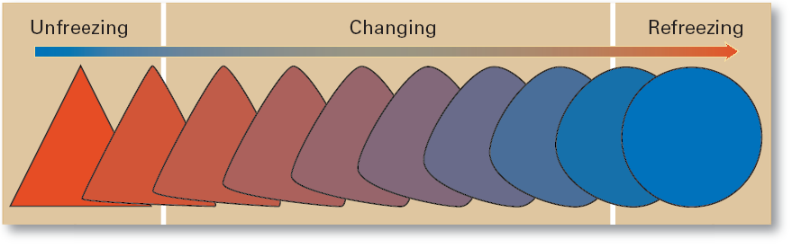
Exhibit 13–1 The Change Process

Slide 6
Change Agents
Change Agents
  Persons who act as catalysts and assume the responsibility for managing the change process.
Types of Change Agents
  Managers: internal entrepreneurs
  Nonmanagers: change specialists
  Outside consultants: change implementation experts

Slide 7
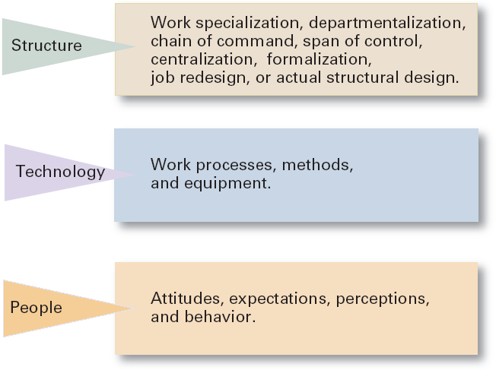
Exhibit 13–2 Three Categories of Change

Slide 8
Types of Change
Structural
  Changing an organization’s structural components or its structural design
Technological
  Adopting new equipment, tools, or operating methods that displace old skills and require new ones
    Automation: replacing certain tasks done by people with machines
    Computerization
People
  Changing attitudes, expectations, perceptions, and behaviors of the workforce
Organizational development (OD)
  Techniques or programs to change people and the nature and quality of interpersonal work relationships.

Slide 9

Organizational Development
Organizational Development (OD)
  Techniques or programs to change people and the nature and quality of interpersonal work relationships.
Global OD
  OD techniques that work for U.S. organizations may be inappropriate in other countries and cultures.

Slide 10
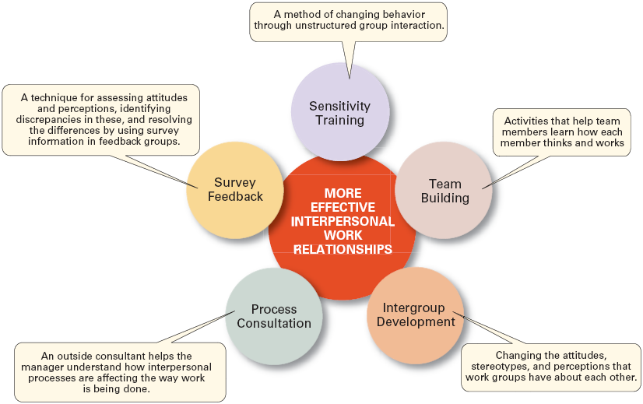
Exhibit 13–3 Organizational Development Techniques
Notes:
یک میتودی برای تغیر رفتار افراد به طور گروپ های ارتباطی غیر ساختار یافته.
فعالیت های که اعضای گروپ را کمک میکند تا چگونه هر عضو نسبت به یک دیگر فکر میکنند.
توسعه میان گروهی – تغیر در رفتار،‌درک و دیدگاه گروپ های کاری نسبت به یکدیگر
یک مشاور خارجی مدیران را قادر میسازد تا درک کنند که روابط میان فردی چقدر در روند کاری شان تاثیر میگذرد.
یک تکنیک برای ارزیابی نگرش ها و برداشت، شناسایی اختلاف، و حل و فصل اختلافات با استفاده از اطلاعات مطالعه شده در گروه و گرفتن بازخورد.

Slide 11
Managing Resistance to Change
Why People Resist Change?
  The ambiguity and uncertainty that change introduces
  The comfort of old habits
  A concern over personal loss of status, money, authority, friendships, and personal convenience
  The perception that change is incompatible with the goals and interest of the organization

Slide 12
Exhibit 13–4 Managerial Actions to Reduce Resistance to Change
Education and communication
Participation
Facilitation and support
Negotiation
Manipulation and co-optation
Selecting people who accept change
Coercion
Notes:
Coercion – کوارشن - اجبار

Slide 13
Issues in Managing Change (cont’d)
Changing Organizational Cultures
  Cultures are naturally resistant to change.
  Conditions that facilitate cultural change:
    The occurrence of a dramatic crisis
    Leadership changing hands
    A young, flexible, and small organization
    A weak organizational culture
Notes:
Korian Air – Change Culture by top- down mana
dramatic crisis – Financial Crises , lose of customer
New Leadership

Slide 14
Issues in Managing Change (cont’d)
Handling Employee Stress
  Stress
    The adverse reaction people have to excessive pressure placed on them from extraordinary demands, constraints, or opportunities.
    Functional Stress
      Stress that has a positive effect on performance.
  How Potential Stress Becomes Actual Stress
    When there is uncertainty over the outcome.
    When the outcome is important.
Notes:
Demand, Constraints, Opportunities

Slide 15
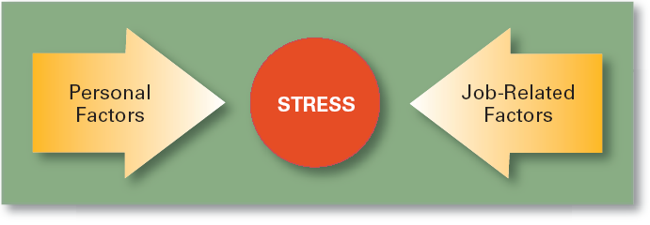
Exhibit 13–6 Causes of Stress

Slide 16
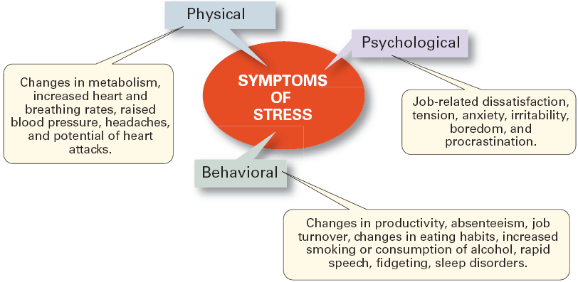
Exhibit 13–7 Symptoms of Stress
Notes:
Irritability زود رنجی
Boredom ملالت
Procrastination طفره تعویق
Fidgeting ناراحتی

Slide 17
Issues in Managing Change (cont’d)
Reducing Stress
  Engage in proper employee selection
  Match employees’ KSA’s to jobs’ Tasks, Duties, and Responsibilities (TDR’s)
  Use realistic job interviews for reduce ambiguity
  Improve organizational communications
  Develop a performance planning program
  Use job redesign
  Provide a counseling program
  Offer time planning management assistance
  Sponsor wellness programs
Notes:
Silicon

Slide 18
Issues in Managing Change (cont’d)
Making Change Happen Successfully
  Embrace change—become a change-capable organization.
  Create a simple, compelling message explaining why change is necessary.
  Communicate constantly and honestly.
  Foster as much employee participation as possible—get all employees committed.
  Encourage employees to be flexible.
  Remove those who resist and cannot be changed.
Notes:
Case study in US shows good scores of job ability and dissatisfactory of change management
All level manager tasks

Slide 19
Your Assignment

Slide 20
Stimulating Innovation
Creativity
  The ability to combine ideas in a unique way or to make an unusual association.
Innovation
  Turning the outcomes of the creative process into useful products, services, or work methods.
Idea Champion
  Dynamic self-confident leaders who actively and enthusiastically inspire support for new ideas, build support, overcome resistance, and ensure that innovations are implemented.
Notes:
پرورش
تحریک
Structure, culture and HR

Slide 21
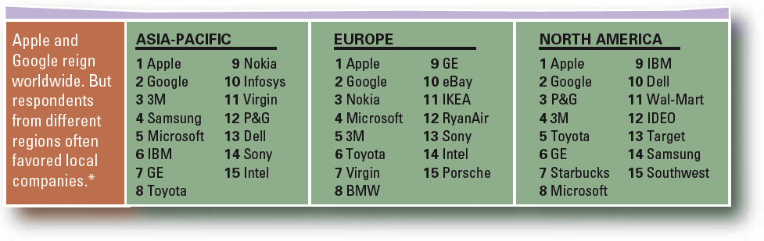
Exhibit 13–9 Innovative Companies Around the World
Data: Boston Consulting Group * We broke ties by comparing 10-year annualized total shareholder returns. In ties between a public and a private company, the public company was favored.
Source: “A Global Pulse of Innovation,” BusinessWeek, April 24, 2006, p. 74.

Slide 22
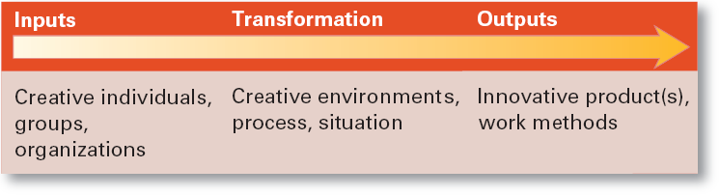
Exhibit 13–10 Systems View of Innovation
Source: Adapted from R.W. Woodman, J.E. Sawyer, and R.W. Griffin, “Toward a Theory of Organizational Creativity,” Academy of Management Review, April 1993, p. 309.

Slide 23
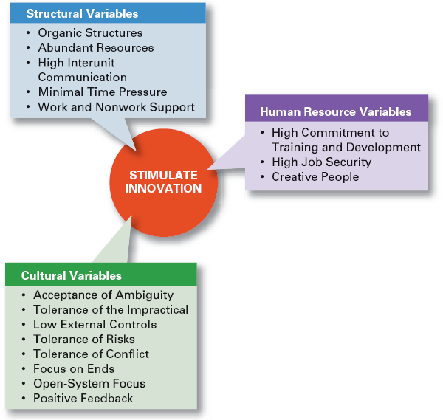
Exhibit 13–11
Innovation Variables

Slide 24
Creating the “Right” Environment for Innovation
Structural Variables
  Adopt an organic structure
  Make available plentiful resources
  Engage in frequent interunit communication
  Minimize extreme time pressures on creative activities
  Provide explicit support for creativity

Slide 25
Creating the “Right” Environment for Innovation (cont’d)
Cultural Variables
  Accept ambiguity
  Tolerate the impractical
  Have low external controls
  Tolerate risk taking
  Tolerate conflict
  Focus on ends rather than means
  Develop an open-system focus
  Provide positive feedback

